Slide 1
Short lectures

Slide 2
Short Lecture: Alignment, reference genomes, denovo assemblies, stacks

Slide 3
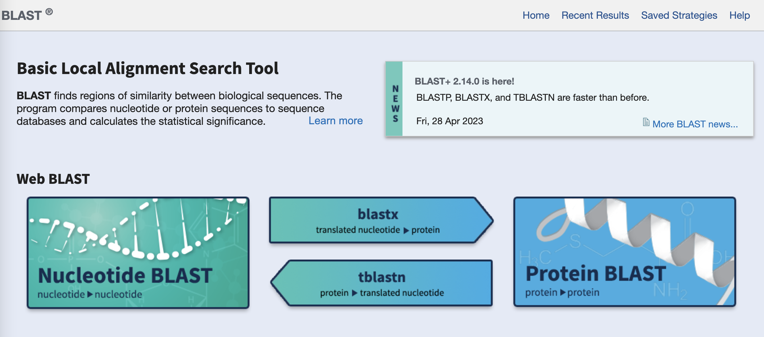
Blast
Finds conserved sequence (seed), then extends.
Mostly looking for homologous sequences, not exact matches
Good for low #’s
Slow!
Need to align hundreds of millions of reads

Slide 4
Short read aligners
We want to find near exact matches within a genome for millions of reads
Usually working with one species
Needs to be
Fast
Accurate
Reference genomes are big
We have MANY reads to align
We don’t want exact matches→ why?

Slide 5
Short read aligners
Reference:
AGTCGGATCACGGTTAGACTTCGACTAAGCGGACCGAATTTGCG
Basic approach: seed-and-extend
Take a subset of your sequence (k; usually ~19)
Find the match in the reference genome (seeding)
Try to extend these matches (extending)
How might we alter k?
shorter = more thorough but slower
longer = less thorough but faster.
Short read:
CACGGTTACACTTCTACT
Break into subsets:
CACGGT TCGACT TCTACT
Seed:
CACGGT
AGTCGGATCACGGTTAGACTTCGACTAAGCGGACCGAATTTGCG
Extend:
CACGGT
AGTCGGATCACGGTTAGACTTCGACTAAGCGGACCGAATTTGCG
TCGACTTCTACT
CACGGT
AGTCGGATCACGGTTAGACTTCGACTAAGCGGACCGAATTTGCG
CACGGT
TCGACTTCTACT
Alignment:
AGTCGGATCACGGTTAGACTTCGACTAAGCGGACCGAATTTGCG

Slide 6
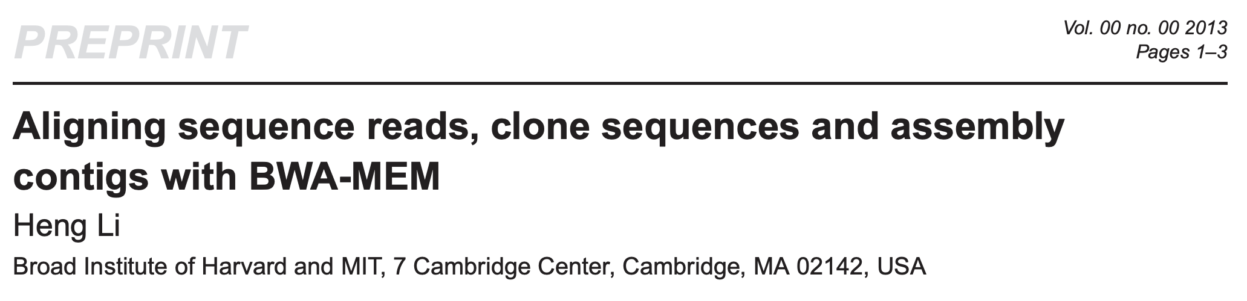
Short read aligners
BWA
Bowtie2
STAR
Pseudo aligners (for RNAseq)
Kallisto
Salmon
And many others…
Depends on what you need
Think read length, speed, accuracy, RNA vs DNA, etc.
BWA: Burrow-Wheeler Aligner for short-read alignment
Burrows-Wheeler Alignment → a compression method
Maximal Exact Match→ longest match that can’t be extended further
Most short read aligners use similar approaches

Slide 7
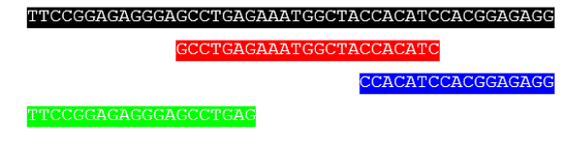
What if I don’t have a genome?
Option 1: Denovo assembly
Best option
Challenging:
Genomes are big
Repetitive
Inversions
Long reads address these issues
PacBio, Nanopore
Can also link scaffolds with other methods:
Hi-C, optical mapping, HiRise, etc.
Repeat regions:
AACCAACCAACCAACCAACCAACCAACCAACC
By Luongdl - Own work, CC BY-SA 3.0, https://commons.wikimedia.org/w/index.php?curid=32630571

Slide 8
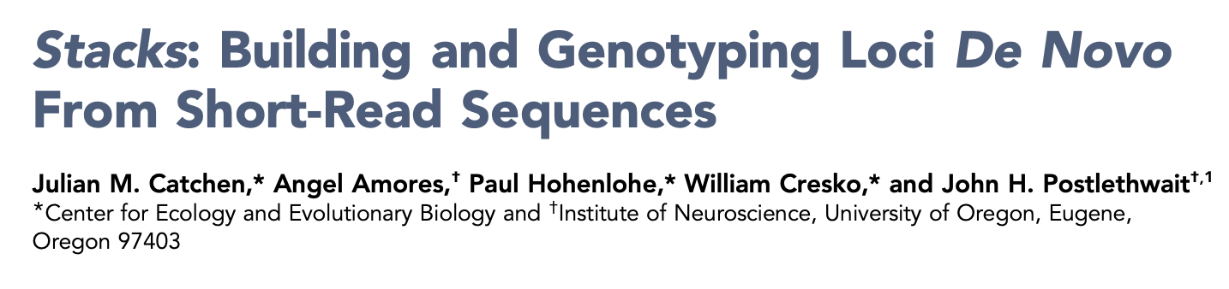
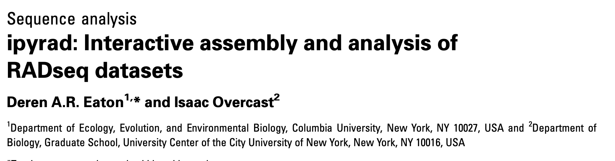
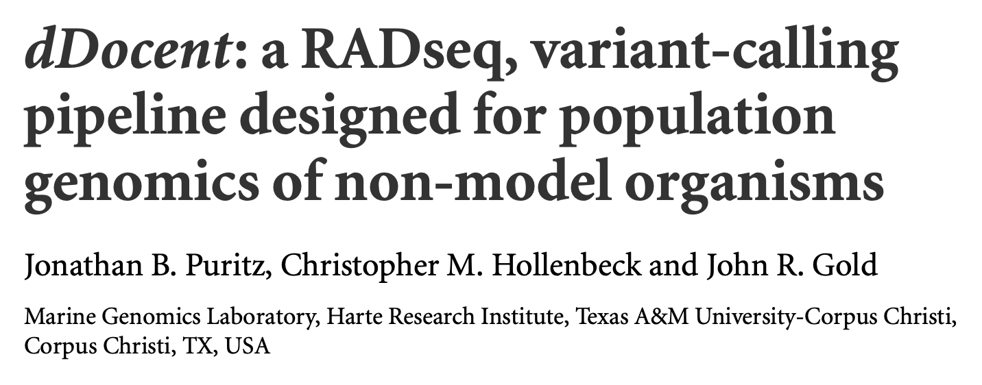
What if I don’t have a genome?
Option 2: Reduced representation
Most commonly RAD-seq/GBS or similar
Still must generate a pseudo reference genome
Stacks, ipyrad, ddocent, others

Slide 9
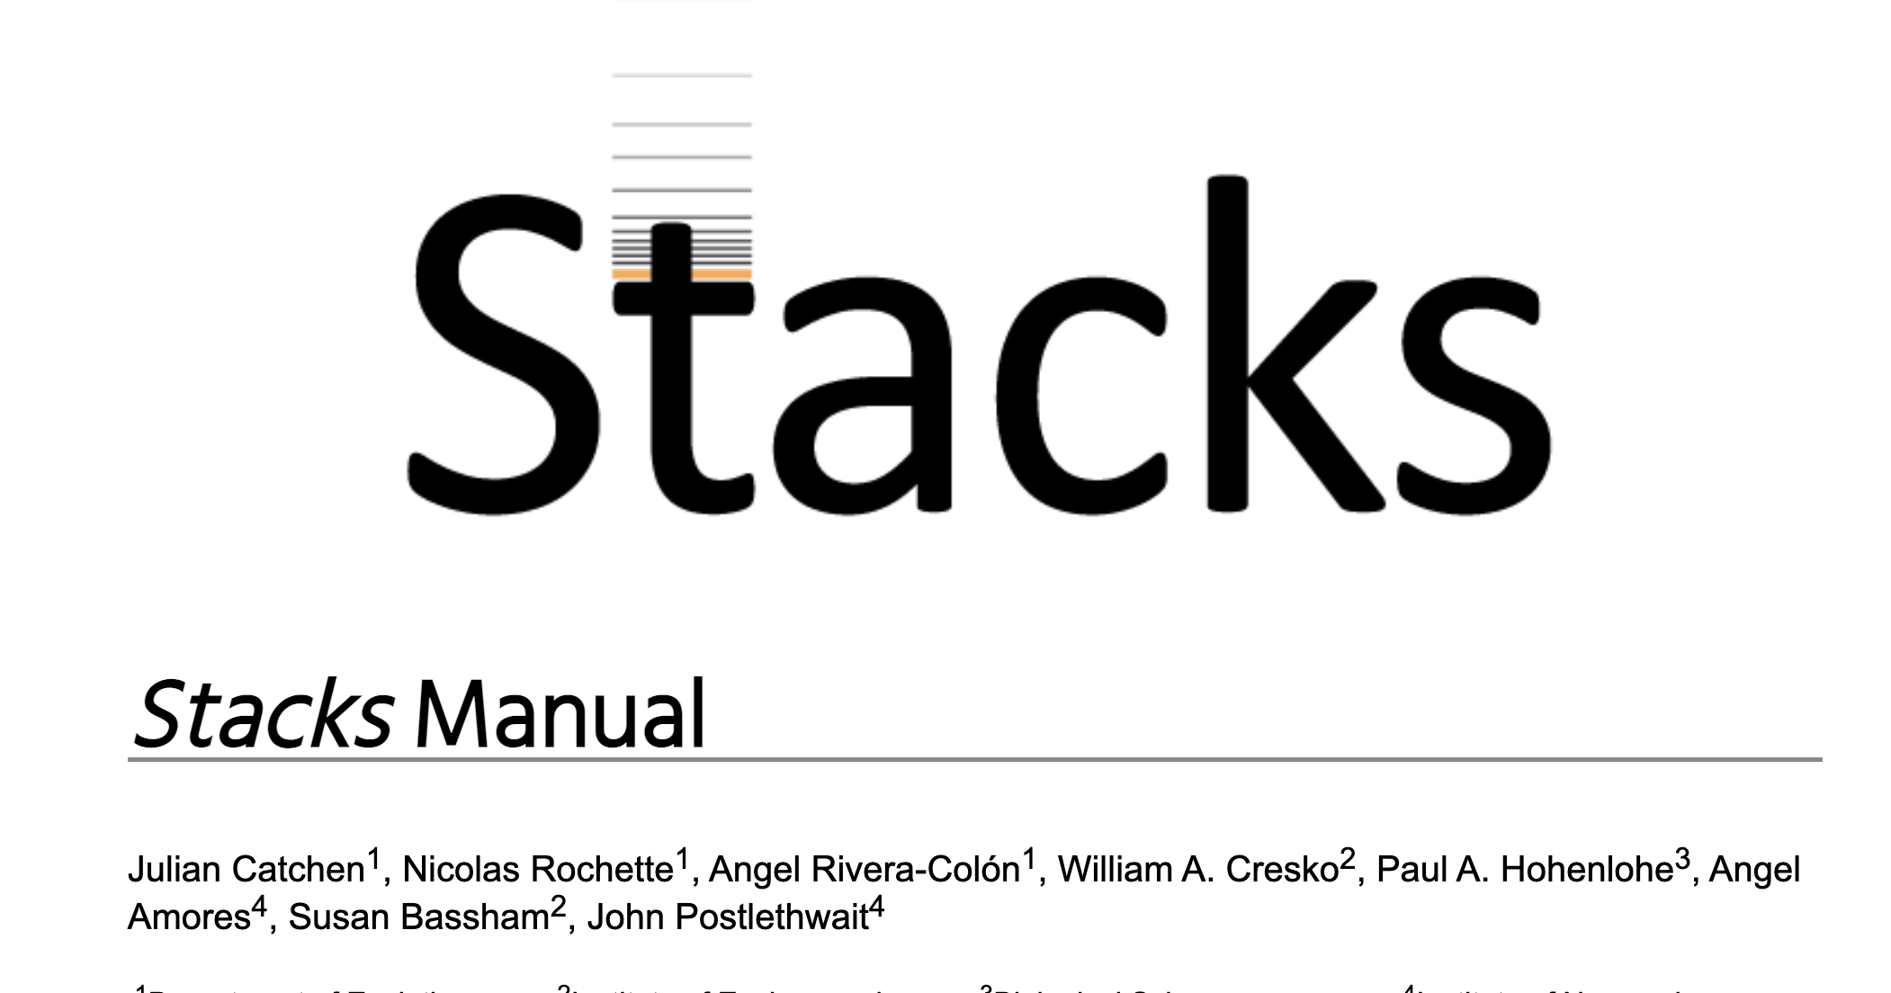
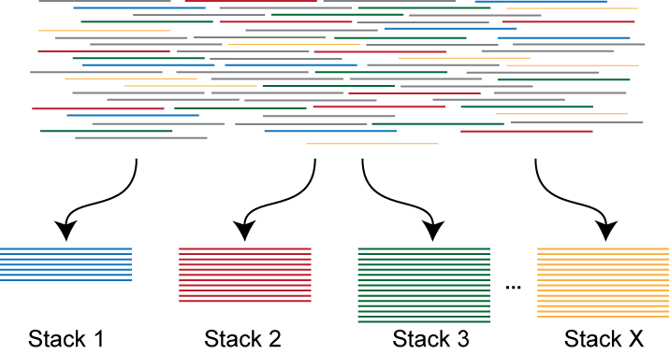
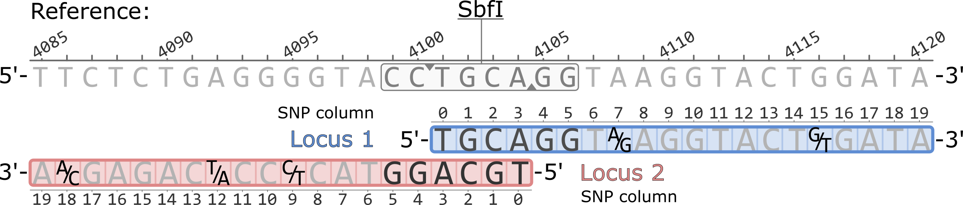
pipeline for de novo rad assembly
Most popular method, good for within species comparisons
Clustering by similarity:
Need to decide:
Minimum depth for a stack
# of mismatches to allow when making a stack
Allow for genetic variation
But not merge different genomic regions
Harder than it seems…
https://catchenlab.life.illinois.edu/stacks/manual/

Slide 10
Short Lecture: Mapping results, PCR duplicates Properly paired multi-mapping

Slide 11
Alignment types
Primary
Secondary
Supplementary
Duplicates
Properly paired

Slide 12
Alignment types
Primary
Secondary
Supplementary
Duplicates
Properly paired
When a read maps to multiple locations, the best alignment
When a read maps to multiple locations, the alternative, alignments (bwa mem doesn’t use this flag, gives quality score of 0 instead)

Slide 13
Alignment types
With reasonable distance (a few hundred bp)
Primary
Secondary
Supplementary
Duplicates
Properly paired
X
X

Slide 14
Alignment types
Primary
Secondary
Supplementary
Duplicates
Properly paired
Split reads

Slide 15
Alignment types
Primary
Secondary
Supplementary
Duplicates
Properly paired

Slide 16
Full genome sequencing
Randomly fragment DNA
PCR amplify
Each DNA fragment should be:
Different length
Different position
Map
False homozygote

Slide 17
Full genome sequencing
Rad seq
False homozygote

Slide 18
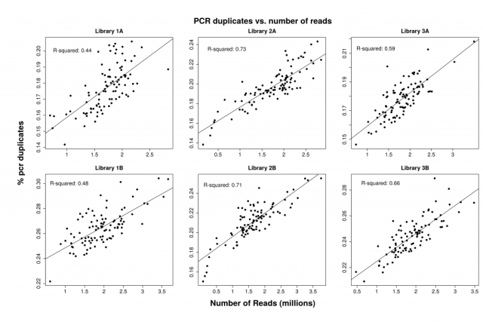
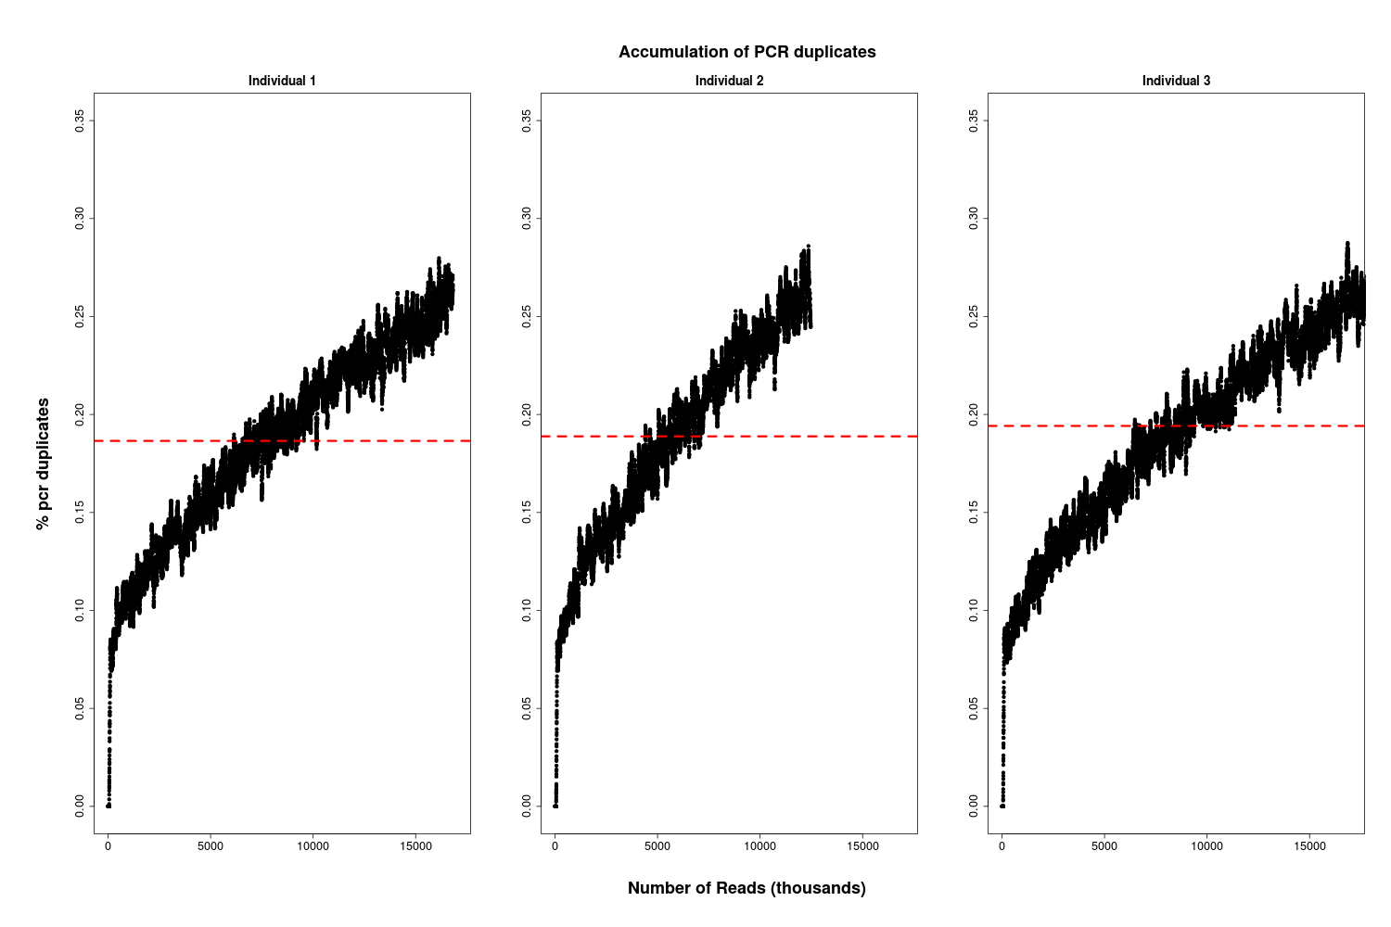
More depth = more duplicates
PCR duplicates accumulate as you process reads
Number of reads (millions)
For more info: https://www.molecularecologist.com/2016/08/25/the-trouble-with-pcr-duplicates/

Slide 19
Short Lecture: Variant calling

Slide 20
Simple in theory:
AGCTAGCCTAGTGACTAAGCCTGA
AGCTAGCCTAGTGACGAAGCCTGA
But in practice:
AGCTAGCCTAGTGACTAAGCCTGA
AGCTAGCCTAGTGACGAAGCCTGA
AGCTAGCCTAGTGACGAAGCCTGA
AGCTAGCCTAGTGACGAAGCCTGA
AGCTAGCCTAGTGACGAAGCCTGA
AGCTAGCCTAGTGACGAAGCCTGA
AGCTAGCCTAGTGACGAAGCCTGA
AGCTAGCCTAGTGACGAAGCCTGA
What is genetic variation, what is an error?

Slide 21
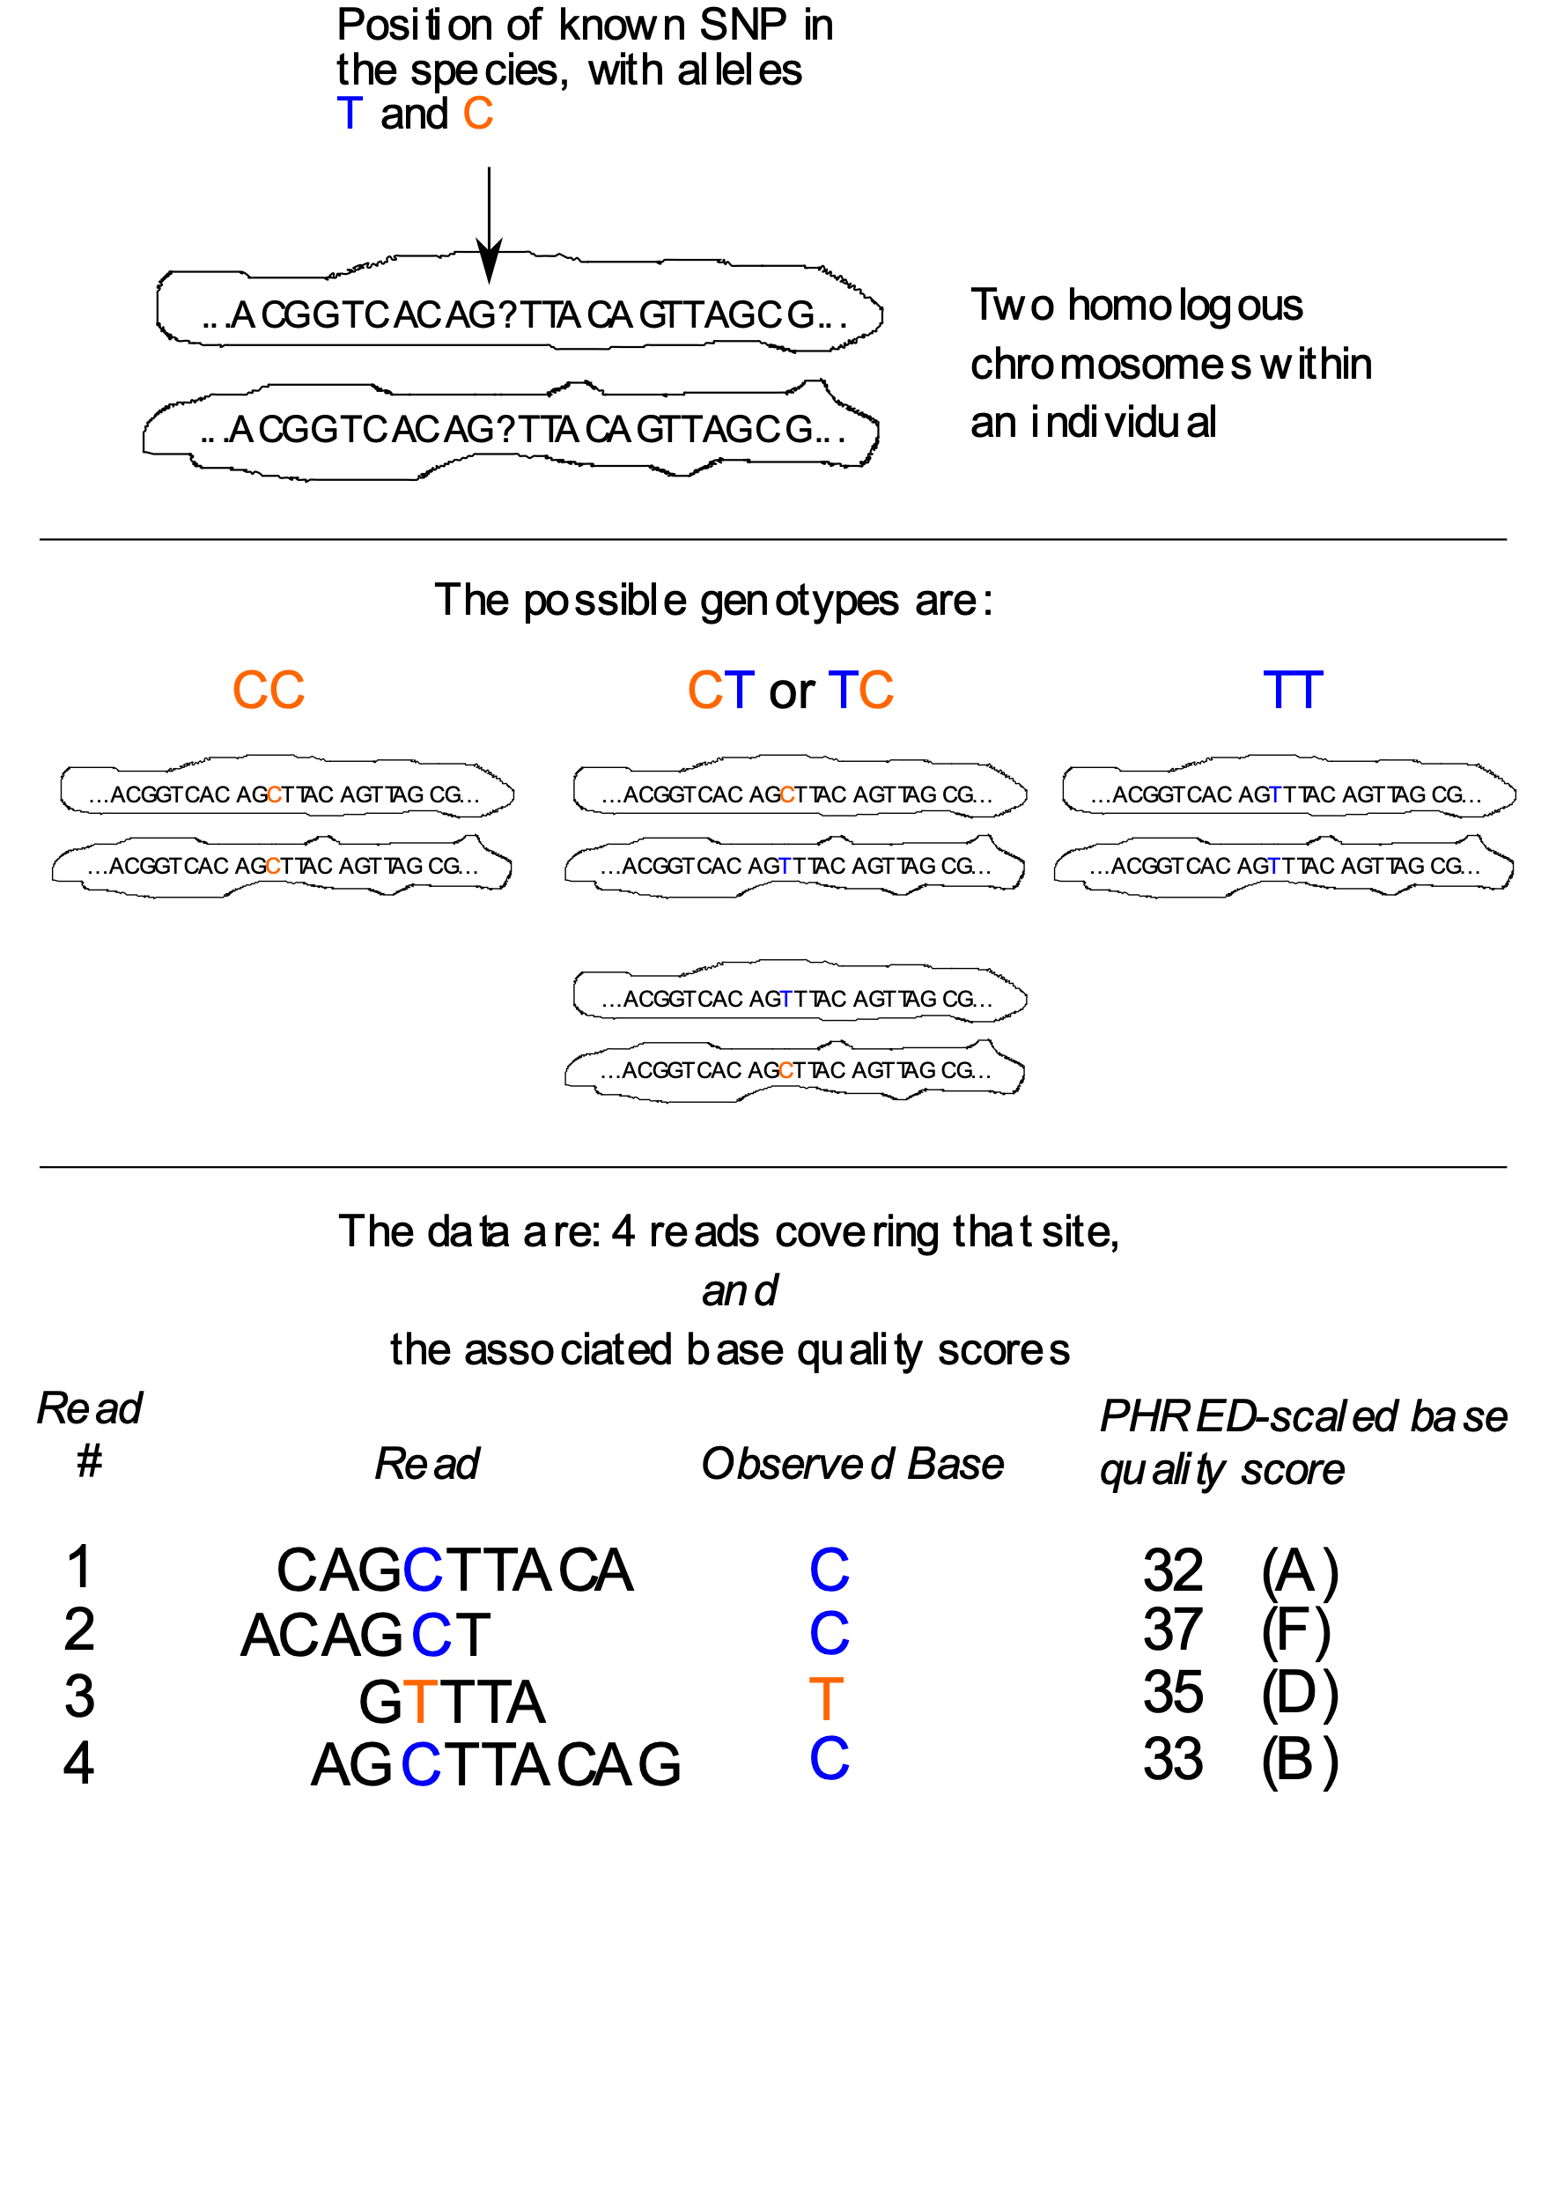
Genotype likelihood
https://eriqande.github.io/eca-bioinf-handbook/variant-calling.html

Slide 22
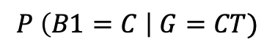
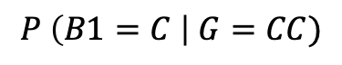
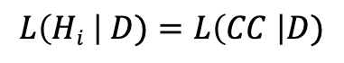
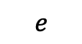
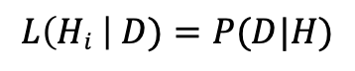
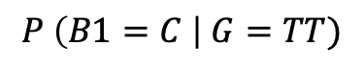
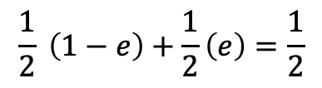
3 hypotheses:
H1: CC
H2: CT
H3: TT
$$L\left(Hi \right| D)=P(D|H)$$
$$L\left(Hi \right| D)=L\left(CC \right|D)$$
What’s the probability of observing our data (C,C,T,C) given our hypothesis (CC) is true?
We assume reads are randomly sampled from each chromosome and there is an error rate
If e = 0.00063
Genotype likelihoods if we have only one read that is C
$$P \left(B1=C \right| G=CC)$$
1-e
0.99937
$$\frac{1}{2} \left(1−e\right)+\frac{1}{2}\left(e\right)=\frac{1}{2}$$
$$P \left(B1=C \right| G=CT)$$
0.5
$$P \left(B1=C \right| G=TT)$$
$$e$$
0.00063
https://eriqande.github.io/eca-bioinf-handbook/variant-calling.html

Slide 23
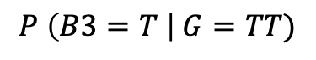
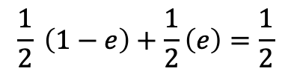
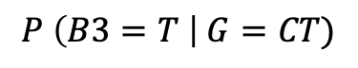
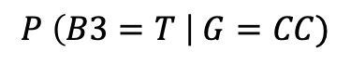
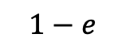
3 hypotheses:
H1: CC
H2: CT
H3: TT
If we have only read 3 (T), basically the opposite results:
If e = 0.00063
$$P \left(B3=T \right| G=CC)$$
e
0.00063
$$\frac{1}{2} \left(1−e\right)+\frac{1}{2}\left(e\right)=\frac{1}{2}$$
$$P \left(B3=T \right| G=CT)$$
0.5
What if we have one additional C?
$$P \left(B3=T \right| G=TT)$$
$$1−e$$
0.99937
Multiply the probabilities together to get total likelihood:
L(G=CC|B1=C,B3=T)= 0.99937*0.00063 = 0.0006
L(G=CT|B1=C,B3=T)= 0.5*0.5 = 0.25
L(G=TT|B1=C,B3=T)= 0.99937*0.00063 = 0.0006
https://eriqande.github.io/eca-bioinf-handbook/variant-calling.html

Slide 24
Short Lecture: Selection Scans

Slide 25
Detecting selection in genomic data
Outlier scans
Basic fst based
More complex:
Bayscan, outflank, etc.
Gene environment associations
Cline analyses
Experimental evolution
Before and after studies
Think hurricanes, sea star wasting, etc.

Slide 26
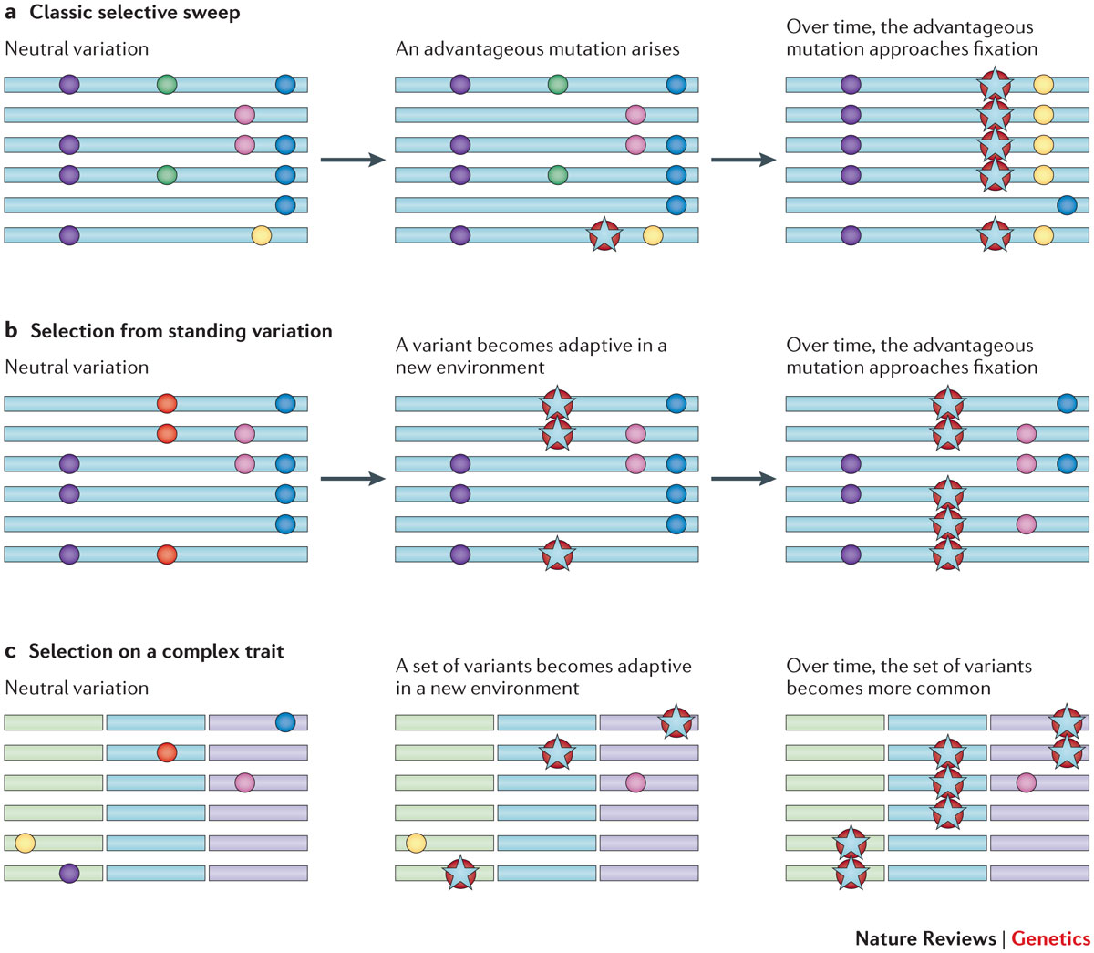
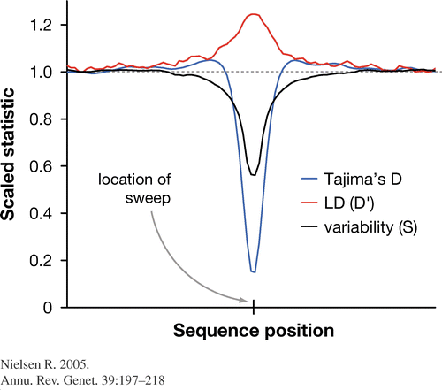
Types of selective sweeps
Elevated: Fst, LD
Decreased: Tajima’s D, genetic diversity

Slide 27
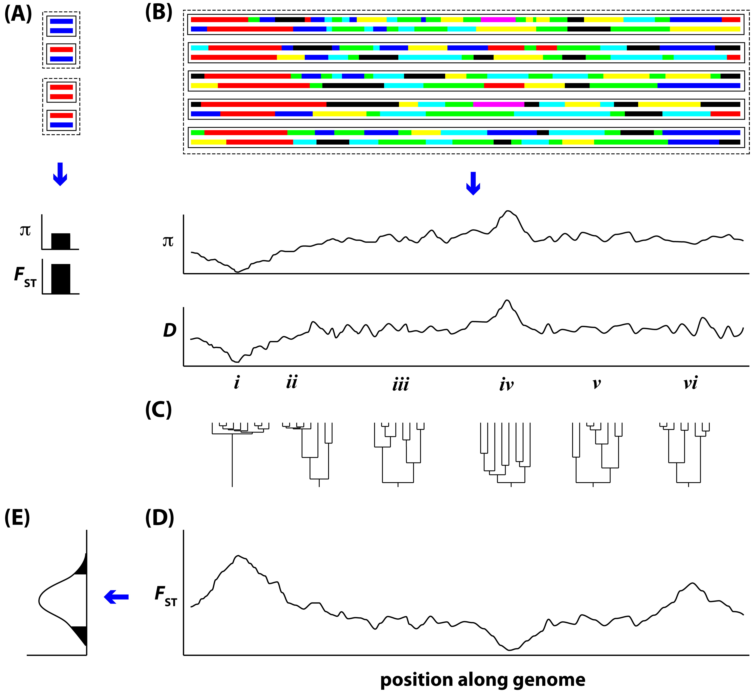
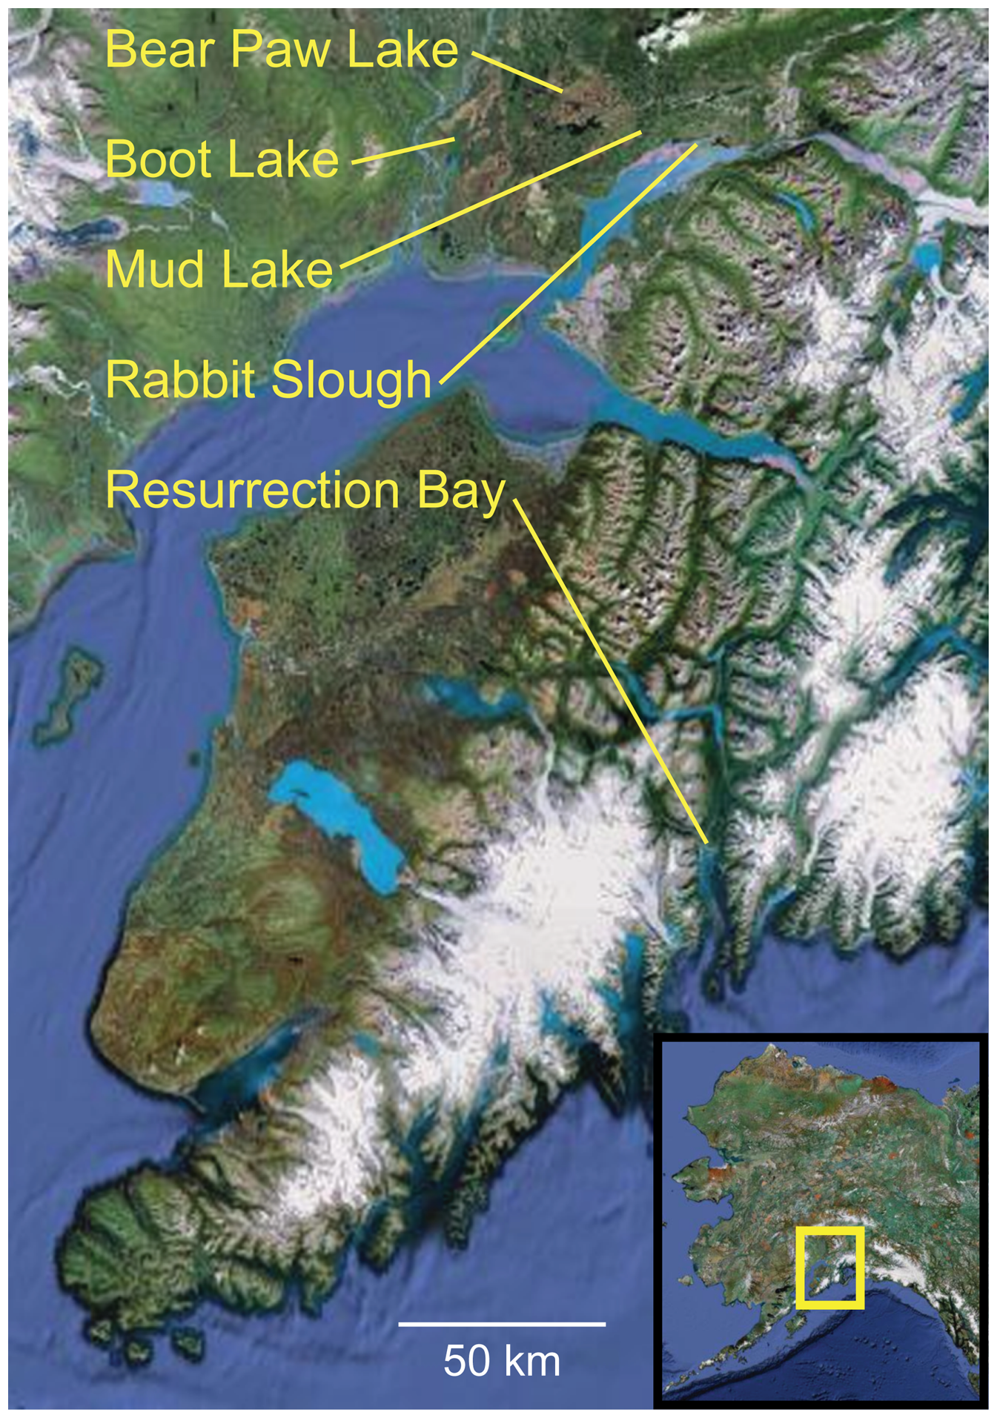
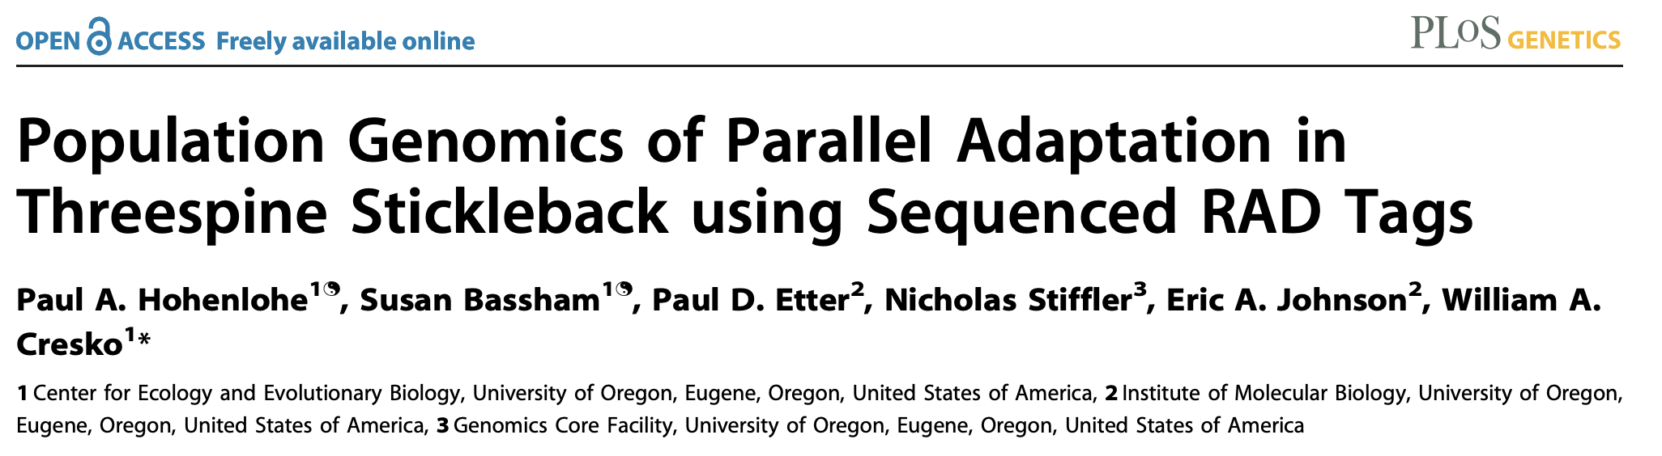
Hohenlohe, Phillips, and Cresko 2010

Slide 28
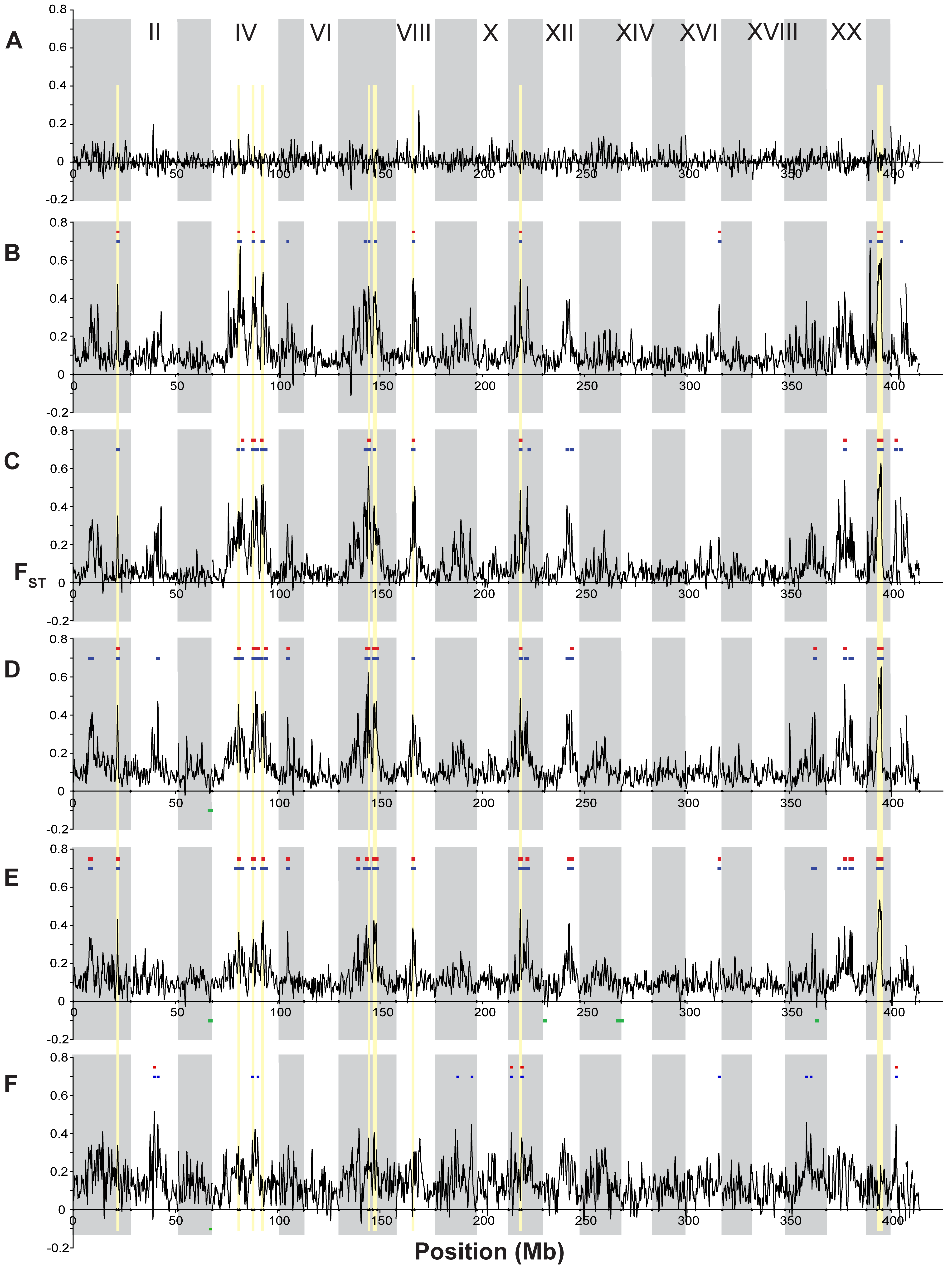
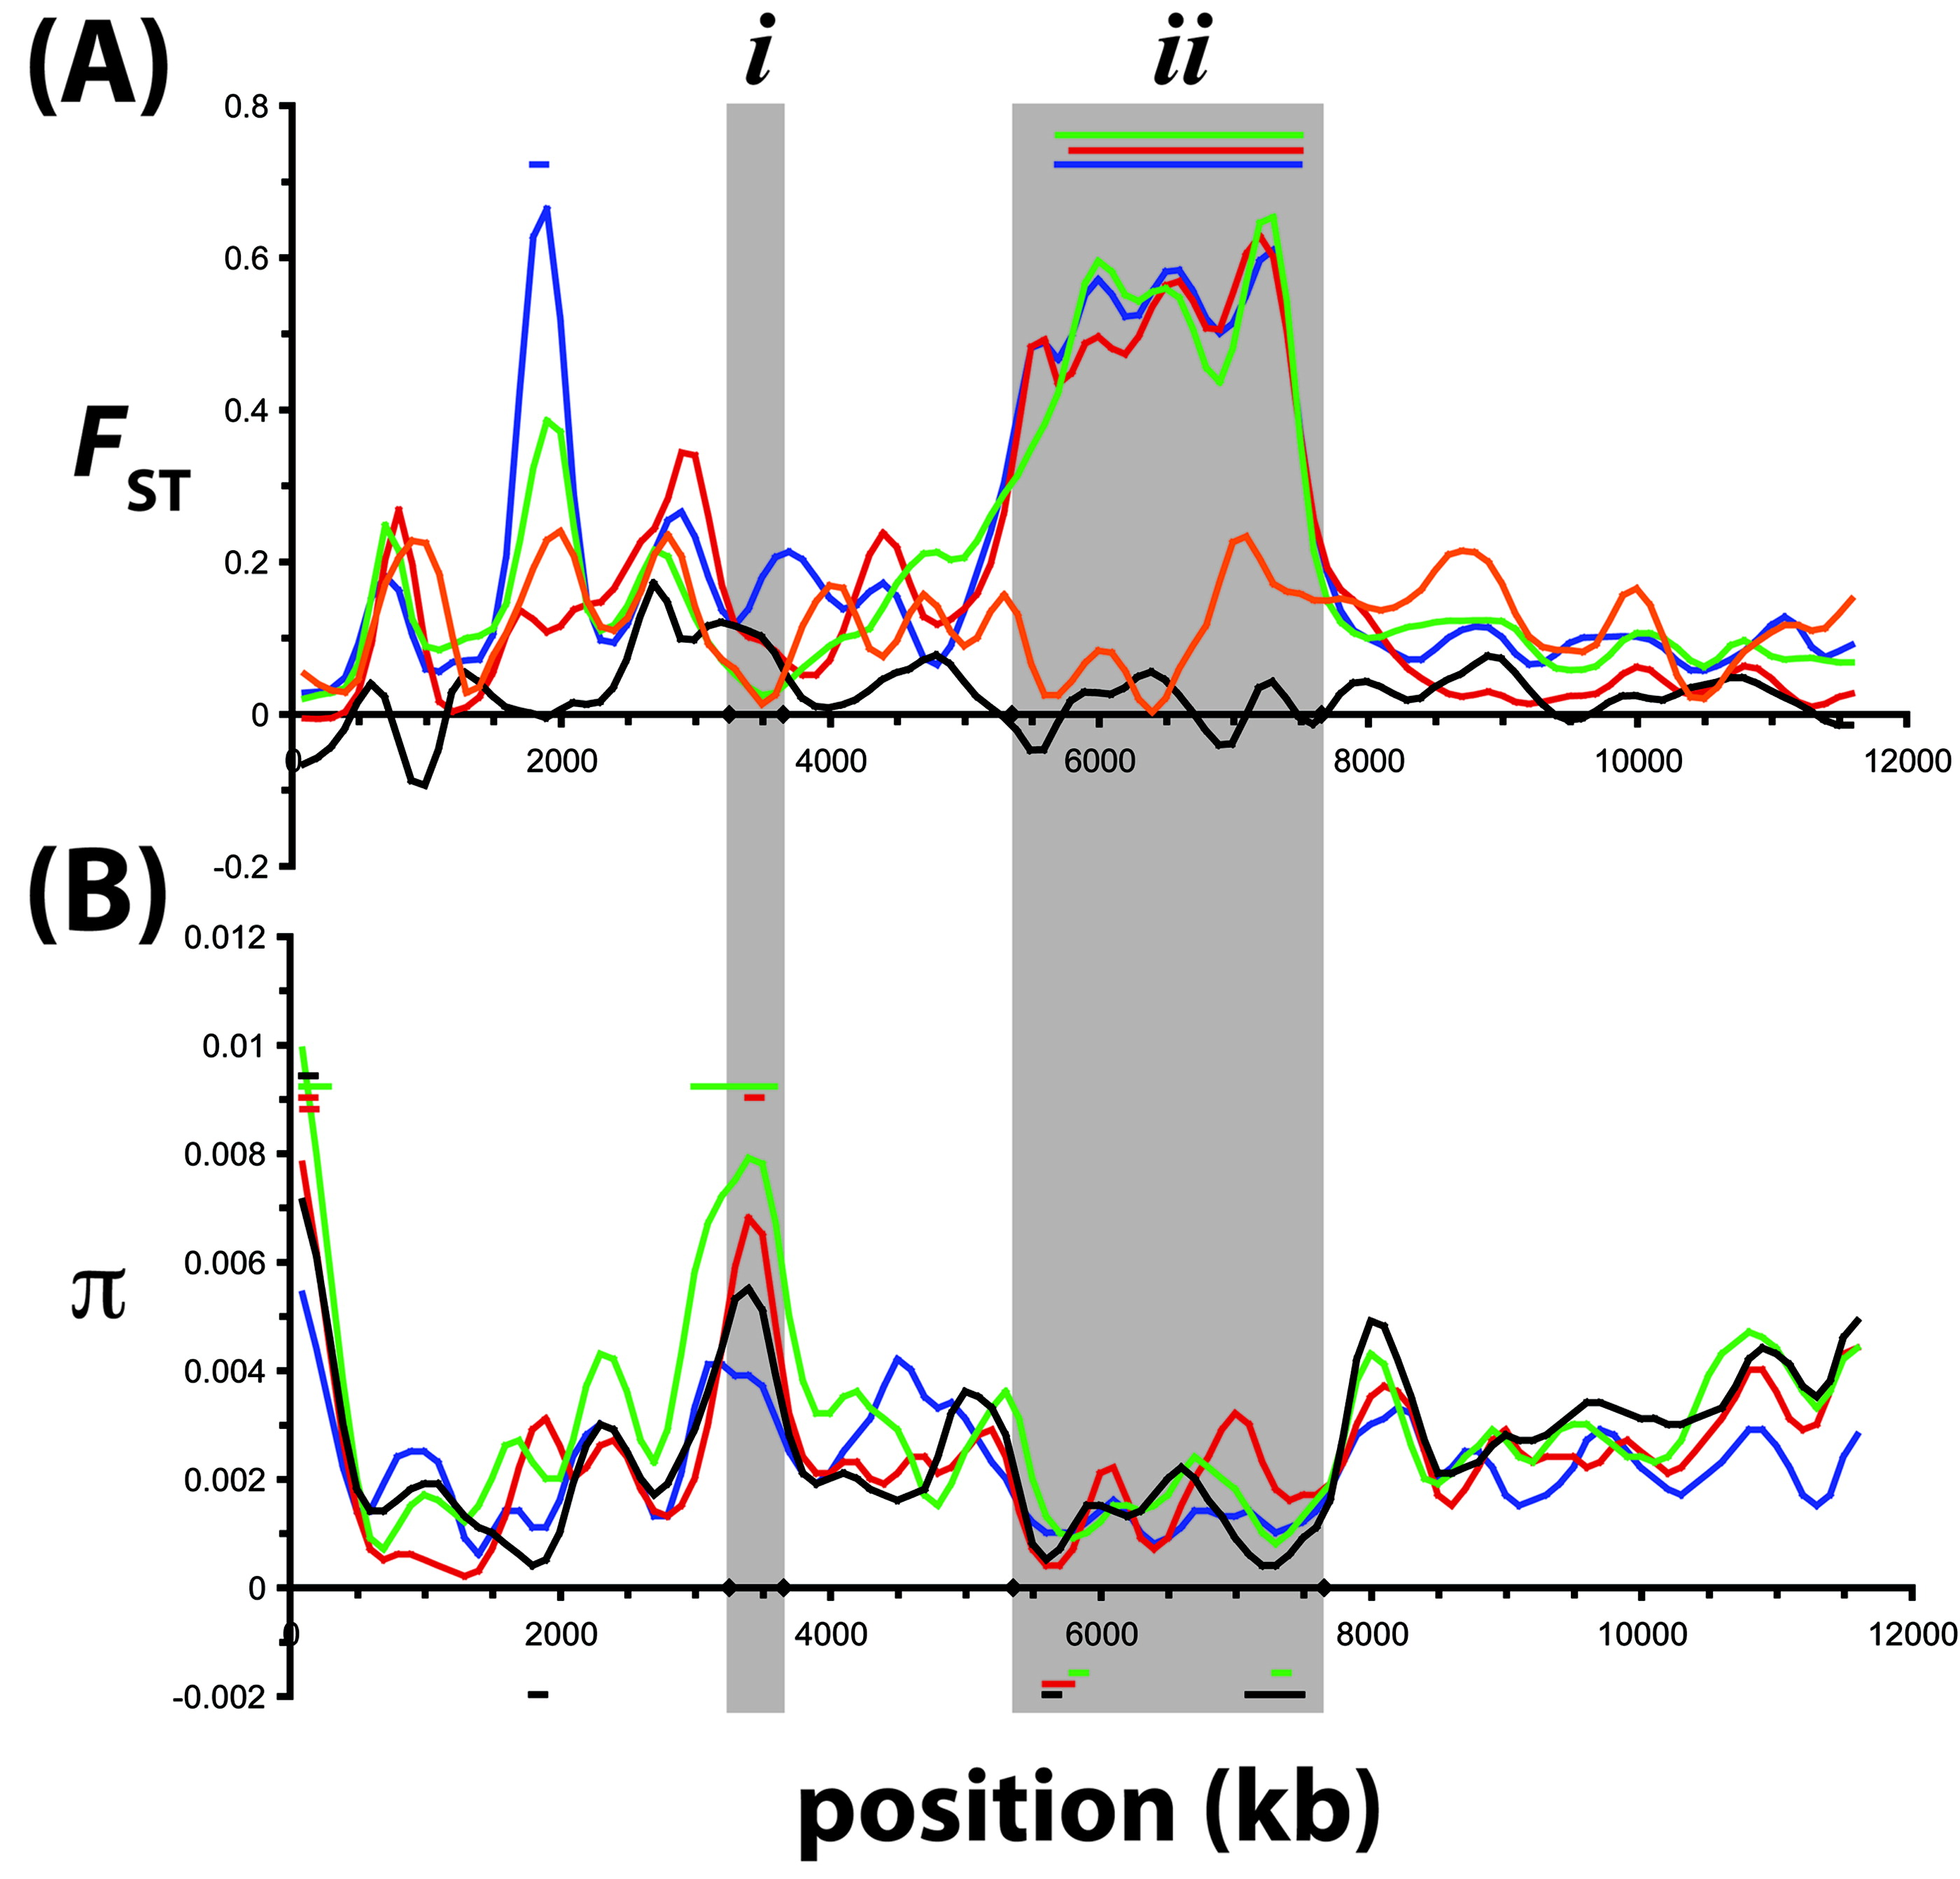
Hohenlohe, Phillips, and Cresko 2010

Slide 29
Detecting outlier regions
What is the null distribution?
How to define “outliers”
Empirical: Tail of the distribution
Fst

Slide 30
Detecting outlier regions
What is the null distribution?
How to define “outliers”
Demographic null
Bayescan
island model in which subpopulation allele frequencies are correlated through a common migrant gene pool from which they differ in varying degrees.
Which loci violate neutrality?

Slide 31
Detecting outlier regions
What is the null distribution?
How to define “outliers”
Empirical: Tail of the distribution
OutFLANK
Fit neutral model
Fst

Slide 32
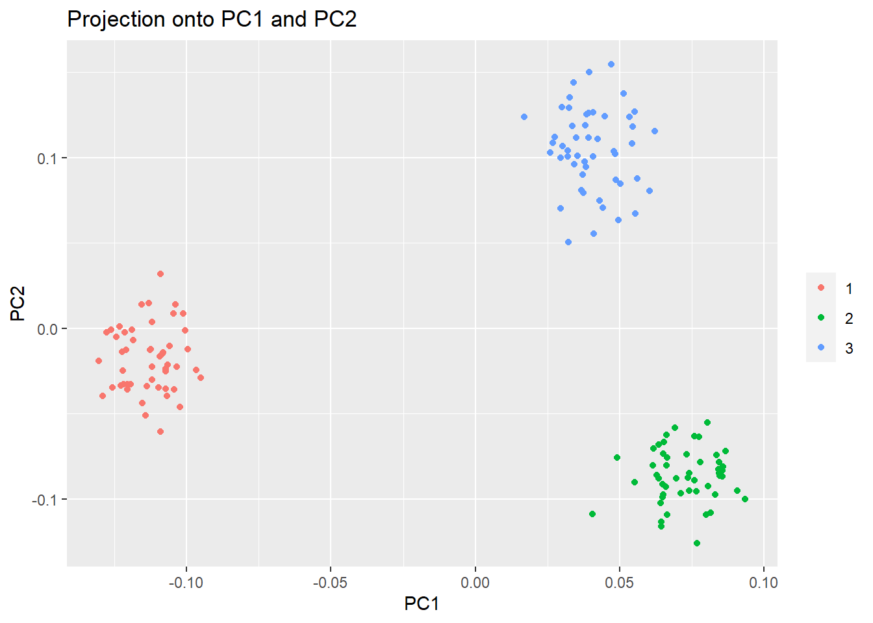
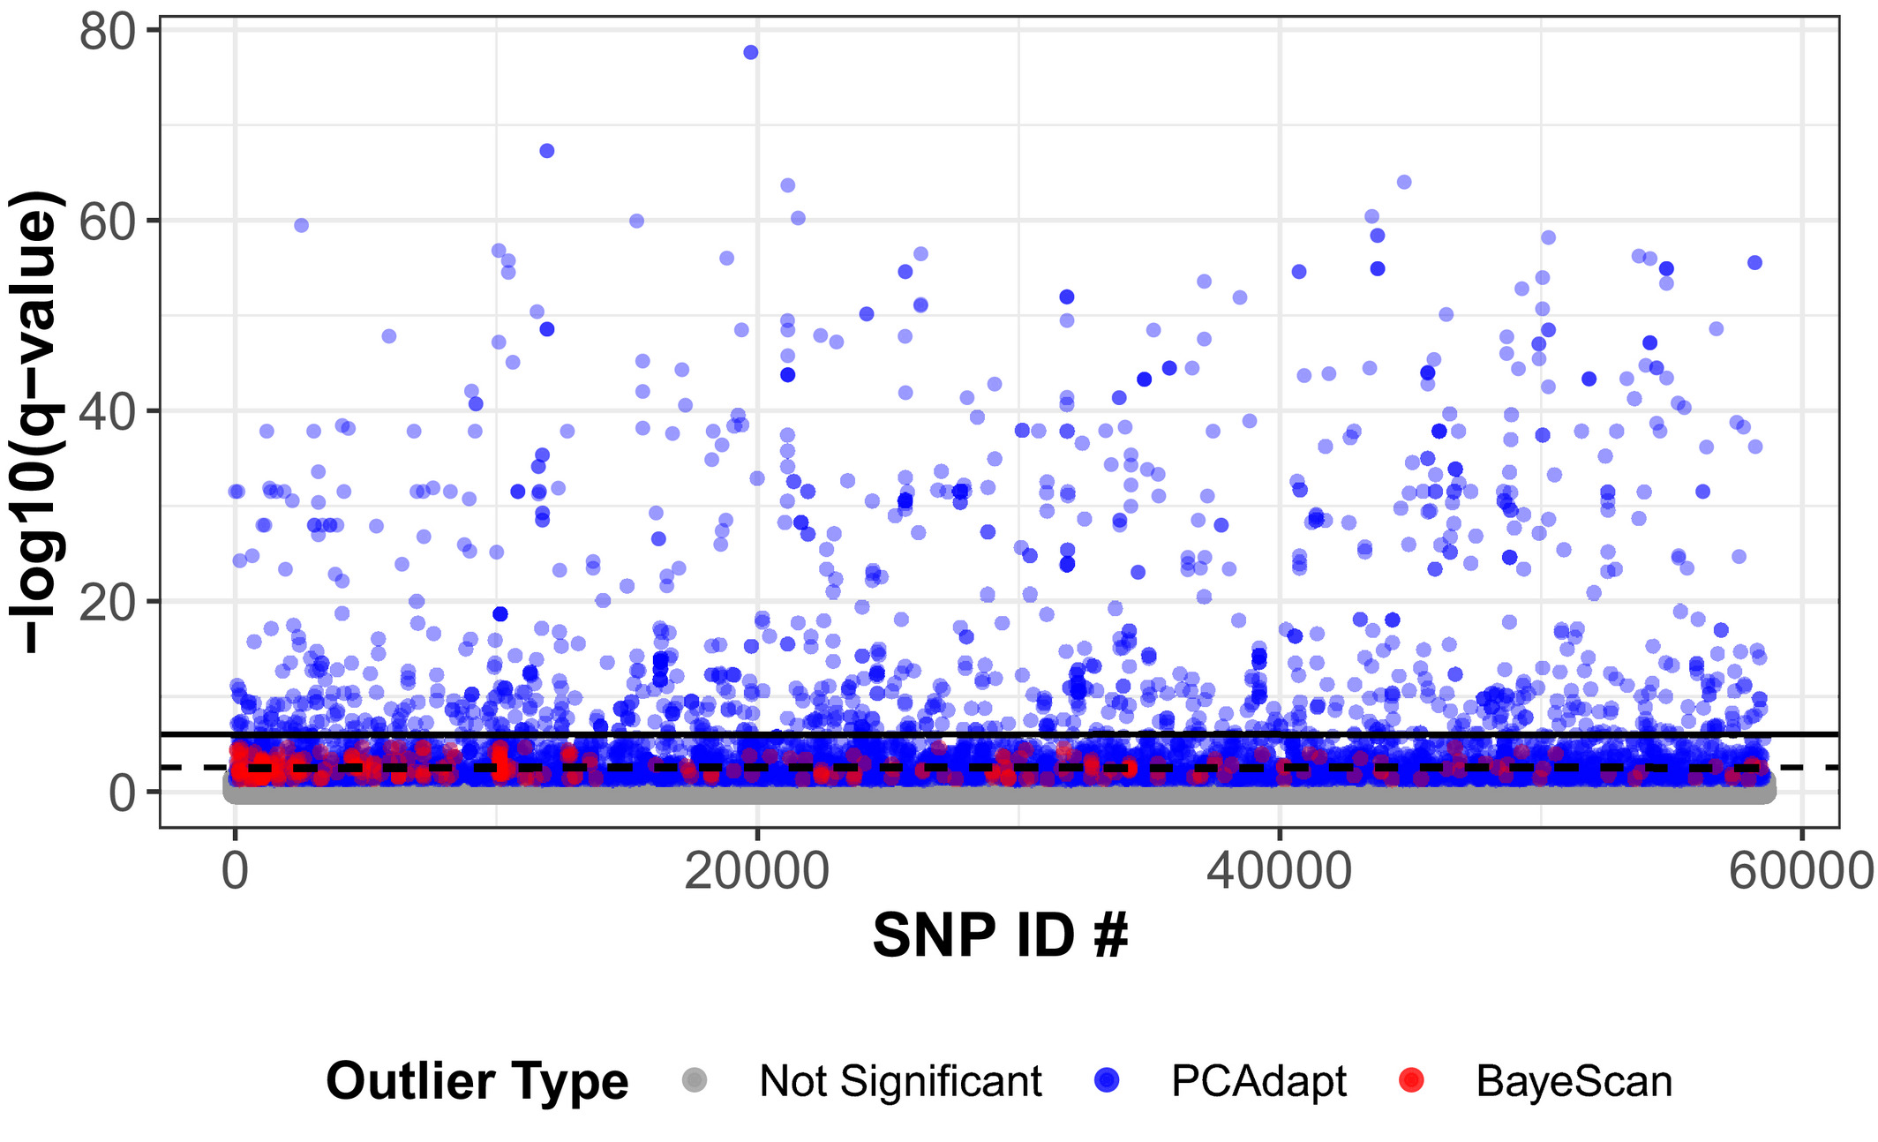
Detecting outlier regions
Estimate covariance/structure among all populations, look for outliers after correction
Baypass, bayenv2
PCAdapt
PCA based
Don’t need population assignments
markers excessively related to population structure are candidates for local adaptation
Reich et al., 2021
Luu, Bazin, Blum 2016

Slide 33
Types of selective sweeps
Haplotype diversity

Slide 34
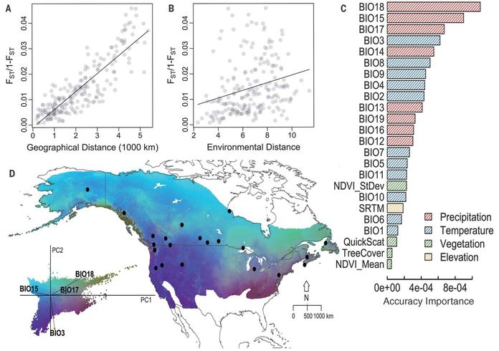
Gene environment associations
Where is there a correlation between the environment and genetics?
Important!
Must control for population structure!
Methods:
Bayenv2
latent factor mixed models: LFMM2
Machine learning
Gradient Forests, random forests

Slide 35
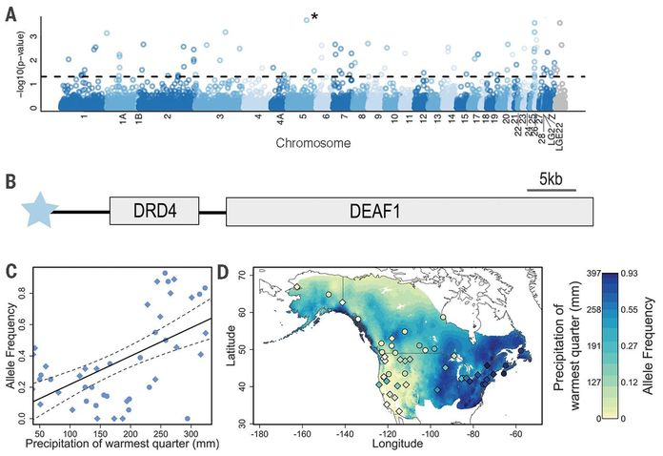

Slide 36
Detecting selection in genomic data
Outlier scans
Basic fst based
More complex:
Bayscan, outflank, etc.
Gene environment associations
Cline analyses
Experimental evolution
Before and after studies
Think hurricanes, sea star wasting, etc.

Slide 37
Types of selective sweeps
Haplotype diversity

Slide 38
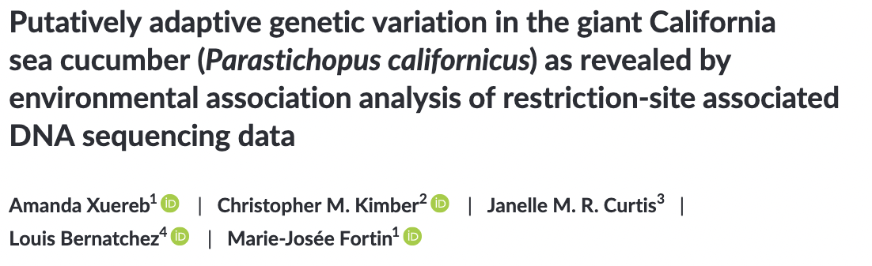
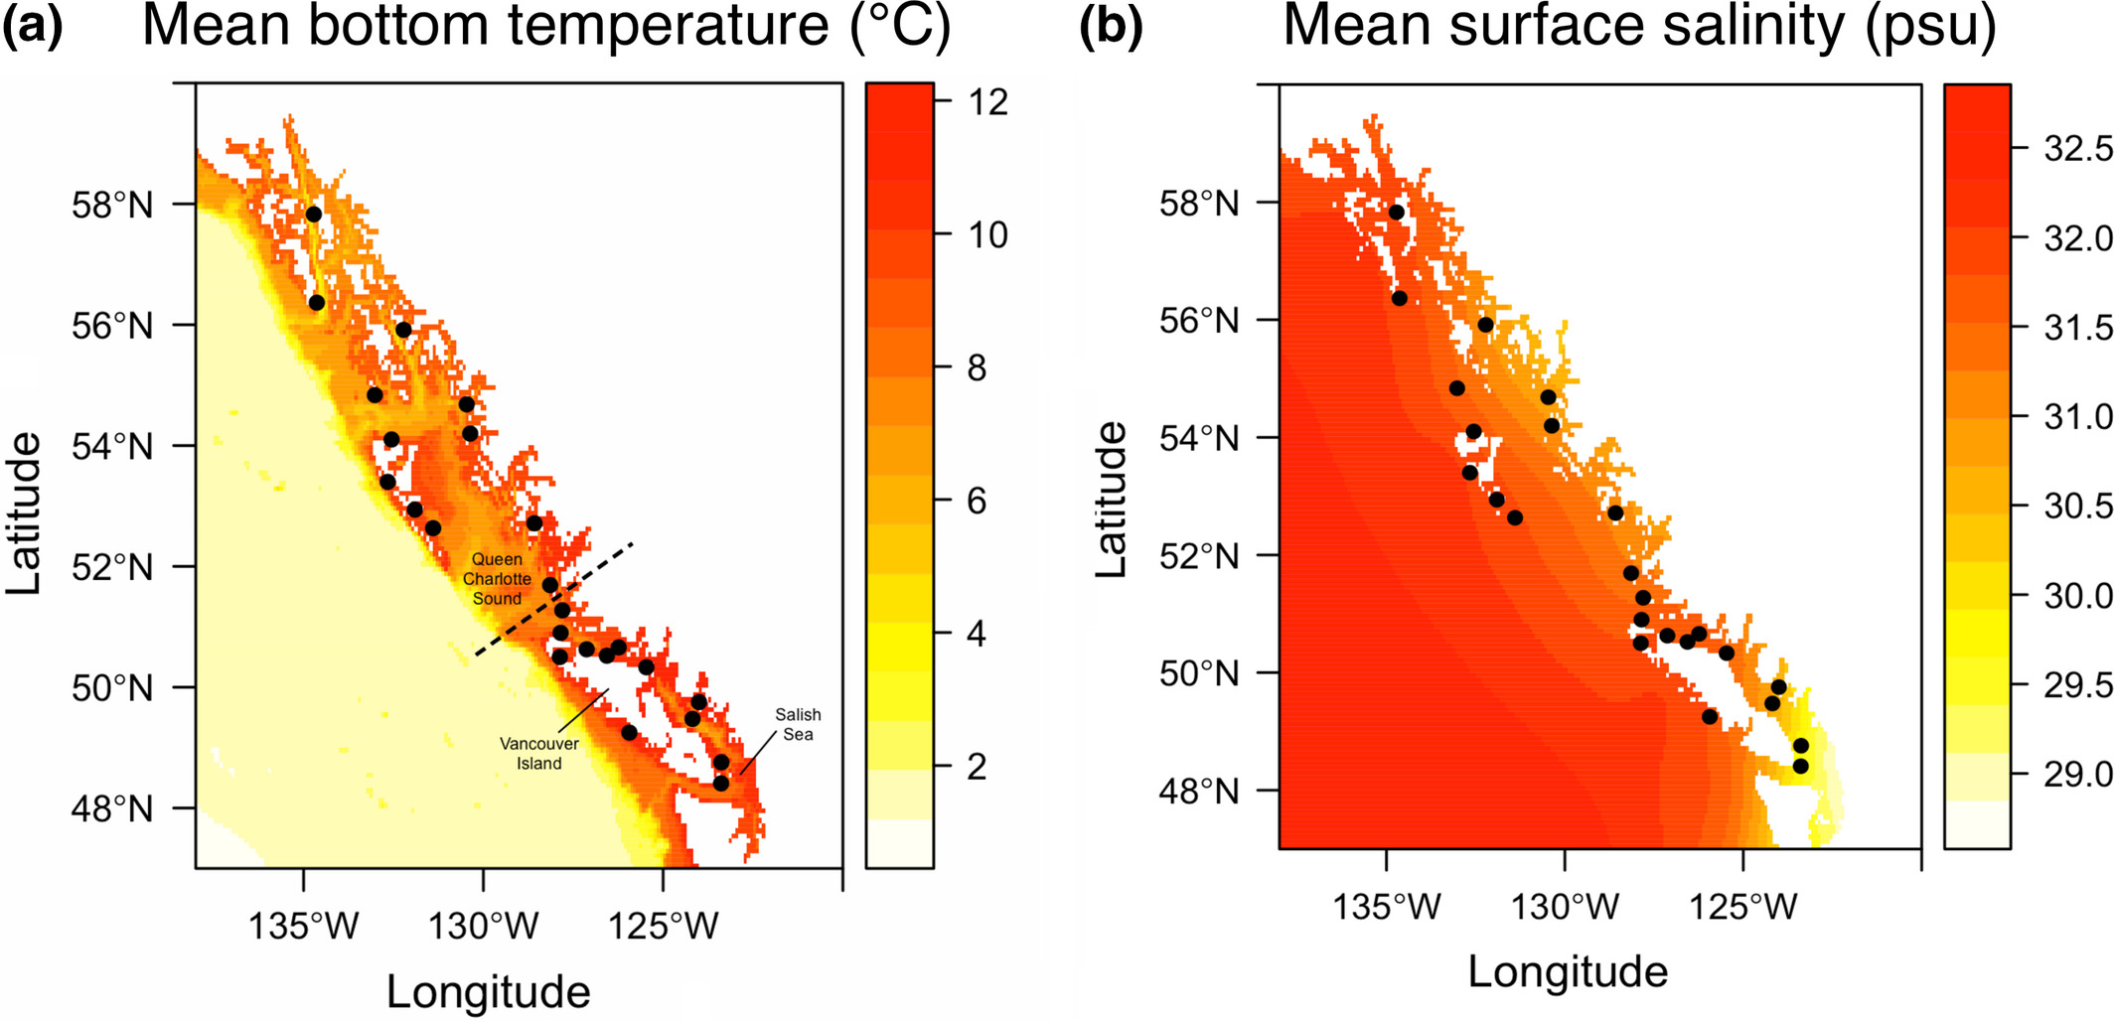

Slide 39
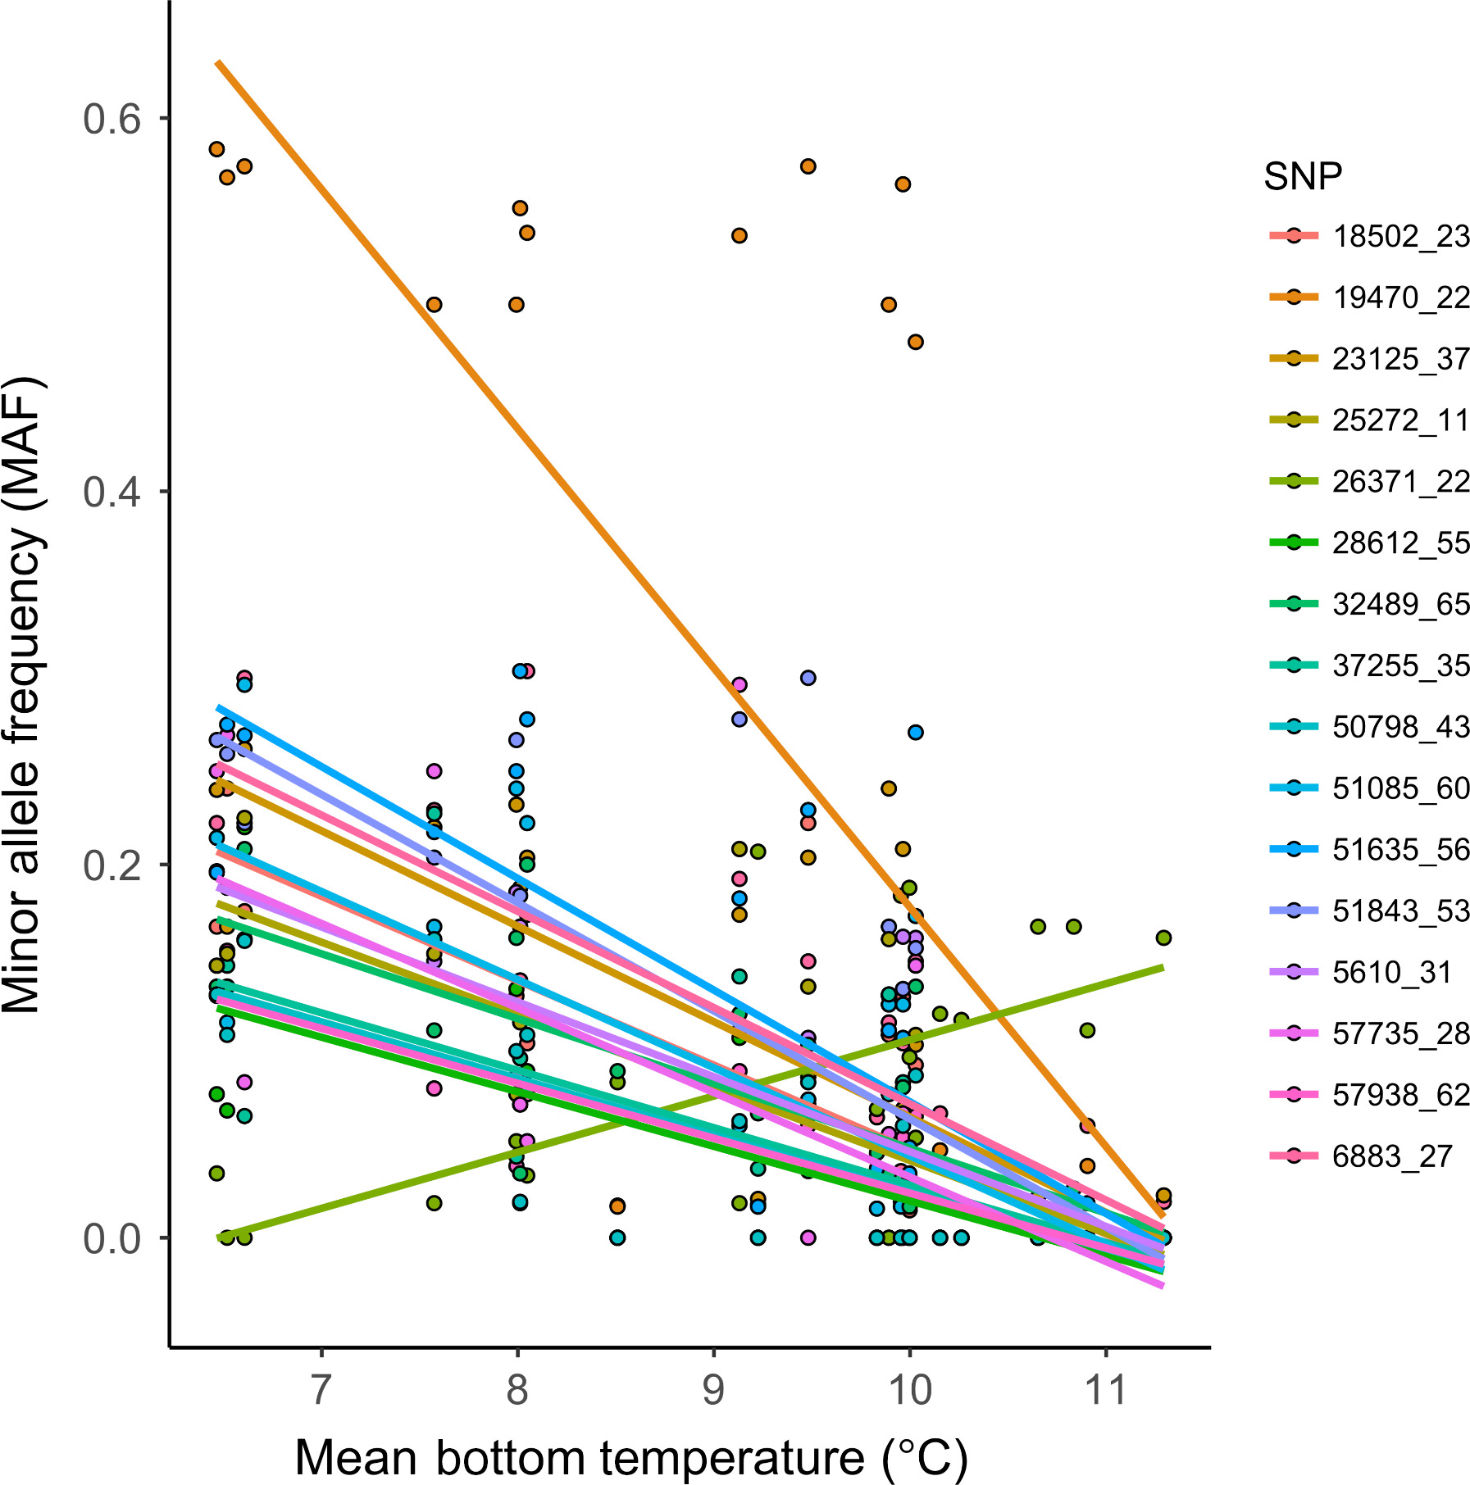
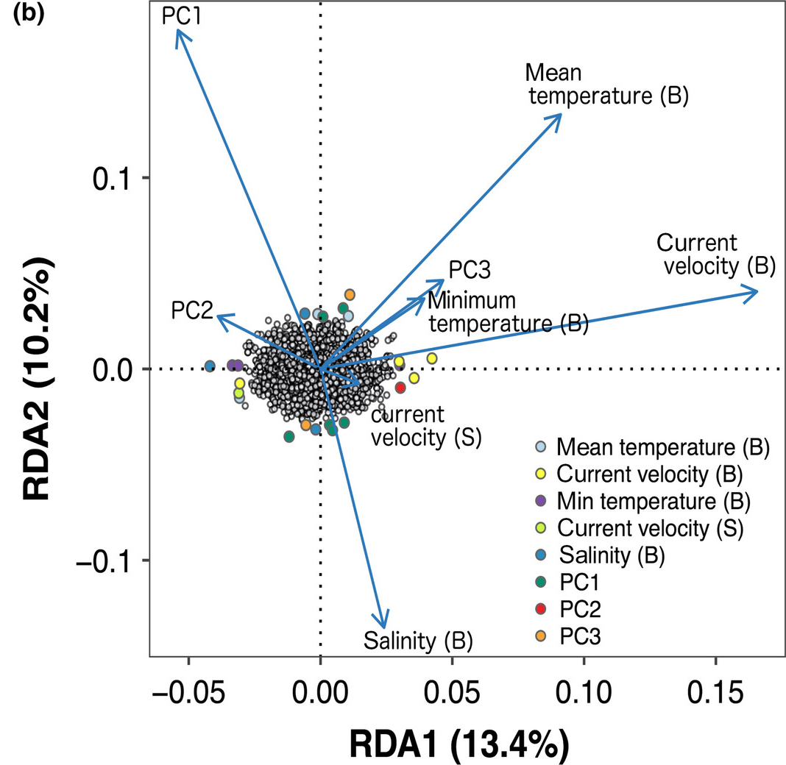

Slide 40
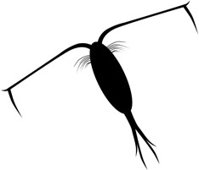
Experimental evolution/Evolve and resequence
Observe evolution as it happens
Look for consistent changes in allele frequencies

Slide 41
Experimental evolution/Evolve and resequence
Selection across generations
A
A
Selection
A
G
Drift
G
G
A
G
A
G
G
A
G
G
G
A
A
A
G
G
A
G
G
A
A
A
A
A
A
A
G
G
G
A
G
A
G
A
G
G
Allele frequency
G
G
A
Allele frequency
A
A
A
A
A
A
G
A
A
G
A
G
A
G
A
A
A
G
G
G
F0
F25
F0
F25

